Slide 1
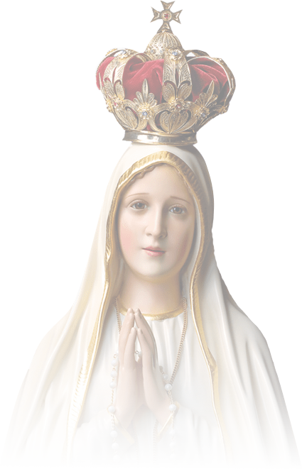
Marian Cenacle Prayer
A Proclamation of the Triumph of the
Immaculate Heart of Mary
(For Use in Zoom or Any Shared Screen Presentation)

Slide 2
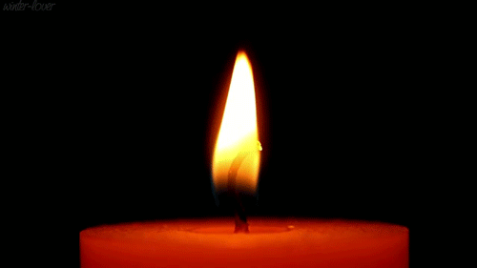
Marian Cenacle Prayer
Divine Indwelling Process
Inhaling and Exhaling
Your breath is the life of God
Relaxing the body
Emptying the mind
(close your eyes)

Slide 3
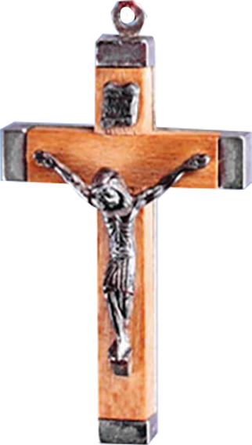
Marian Cenacle Prayer
THE SPIRITUAL BATTLE AND THE SWORD OF THE SPIRIT
In the Name of the Father, and of the Son and of the Holy Spirit…
All: Come, Holy Spirit, come by means of the powerful intercession of the Immaculate Heart of Mary, Your well-beloved Spouse.
Reader: Let us have a moment of silence… Let us relax our body by exhaling very slowly towards our heart…. Let us open our minds as we enter with faith into our heart to be one with the Divine Indwelling in spirit within our soul. With childlike faith let us put ourselves before the throne of God, in the Presence of the Father, the Son and the Holy Spirit in the fullness of their glory and light. (a moment of silent contemplation.)
All angels and saints and the whole court of heaven are in adoration before the Blessed Trinity. By the side of Jesus Our Lord is our Blessed Mother Mary. St. Michael the Archangel is leading all the angels in a full battle array with swords in their right hand and our Lady’s banner on the left. St. Joseph is leading the saints together with all of us who join in Cenacles throughout the world. All are in adoration before God. In unison let us join the heavenly chorus saying:

Slide 4
Marian Cenacle Prayer
THE SPIRITUAL BATTLE AND THE SWORD OF THE SPIRIT
ALL: (The Apostles’ Creed) I believe in God, the Father Almighty, Creator of heaven and earth. I believe in Jesus Christ, His only Son, our Lord. He was conceived by the power of the Holy Spirit and born of the Virgin Mary. He suffered under Pontius Pilate, was crucified, died and was buried. He descended to the dead. On the third day He rose again. He ascended into heaven, and is seated at the right hand of the Father. He will come again in glory to judge the living and the dead. I believe in the Holy Spirit, the Holy Catholic Church, the Communion of Saints, the forgiveness of sins, the resurrection of the body, and life everlasting. Amen.

Slide 5
Marian Cenacle Prayer
THE SPIRITUAL BATTLE AND THE SWORD OF THE SPIRIT
ALL: Our Father….
READER: Let us praise and glorify God our Father in His work of creation.
ALL: Hail Mary….
READER: Let us praise and glorify the Son in His work of Redemption.
ALL: Hail Mary….
READER: Let us praise and glorify the Holy Spirit in His work of Sanctification and Preservation of Creation.
ALL: Hail Mary….
READER: Let us join our Mother and the heavenly Host in their unending Hymn and Praise.
ALL: Glory be……

Slide 6
Marian Cenacle Prayer
THE FIRST MYSTERIES
(For the Whole World)
READER: The First Joyful Mystery is the Annunciation of the Birth of Our Lord Jesus. The angel Gabriel said: “Do not be afraid Mary, you have found favor with God. You will conceive and bear a son, and you shall call him Jesus.” (Luke 1: 30-31) We who are baptized are also full of grace because the Source of all graces, God Himself, is dwelling within us in spirit within our soul.
READER: The First Luminous Mystery is the Baptism of Our Lord Jesus. Jesus came from Nazareth in the province of Galilee, and baptized by John in the Jordan River.” (Mark 1:9) To enter the Kingdom of God we also are to be baptized with water and the Holy Spirit.
READER: The First Sorrowful Mystery is the Agony of Our Lord Jesus in the Garden of Gethsemane. Alone on that dark night in a garden called Gethsemane, Jesus became fearful and disturbed. Kneeling on the ground, praying to His Father that the cup of suffering passed Him by, yet trusting He could drink it if it be God’s will. (Mark 14:32) In all pains and trials we need to exhale and surrender to God dwelling within us to find peace and comfort so we can carry the cross of our daily life.
READER: The First Glorious Mystery is the Resurrection of Our Jesus from the dead. The angel said. “Do not be afraid…He is not here; he is risen as he said.” (Matthew 28:5-6) Christ is already risen but through Baptism He has now come to dwell within us.

Slide 7
Marian Cenacle Prayer
THE FIRST MYSTERIES
(For the Whole World)
1
READER: Let us prepare ourselves for spiritual battle. Let us put in mind that the Word of God is the Sword of the Spirit. Each time we consciously acknowledge the Presence of God in us when we say “Hail, full of grace. THE LORD IS WITH YOU” the light of God shines forth from within our heart to shed its rays upon our intentions in this Cenacle. We dedicate this first decade for the fulfillment of the Plan of God and the conversion of the whole world.
ALL: Our Father.…
2
3
4
5
6
7
8
9
10

Slide 8
Marian Cenacle Prayer
THE FIRST MYSTERIES
(For the Whole World)
1
READER: Let us now look at the Light from the throne of God, the Father, the Son and the Holy Spirit, the Light from the Immaculate Heart of Mary, our Mother and Queen and the Light from among the angels, the saints and from all of us together who are praying the cenacle throughout the world. Through our prayers the Light of God can penetrate every nook and corner of the earth. This same Light of God is now shining upon our intentions.
1) ALL: Hail Mary…
2) ALL: Hail Mary…
2
3
4
5
6
7
8
9
10

Slide 9
Marian Cenacle Prayer
THE FIRST MYSTERIES
(For the Whole World)
1
READER: Mary, our Mother and Queen, is now using this weapon of Divine Light from all of us, her spiritual army, who are doing this Cenacle with contemplation, penance and reparation at this very moment throughout the world to enkindle the weapons of penance and reparation of the Militant Church, especially from all of us who are in Cenacle.
3) ALL: Hail Mary…
4) ALL: Hail Mary…
2
3
4
5
6
7
8
9
10

Slide 10
Marian Cenacle Prayer
THE FIRST MYSTERIES
(For the Whole World)
1
READER: The Light of God from within the hearts and souls of the great army of Mary is now spreading throughout all the nations of the earth. Let us bring and focus the intense power of the Light of God in the troubled areas in order that all traces of darkness of unbelief, moral deviations, wars, and all evil spirits of hate and strife, chaos and confusion lies and deception may completely disappear from the face of the earth thus bringing Peace, Unity, Love and Joy to the world.
5) ALL: Hail Mary…
6) ALL: Hail Mary…
2
3
4
5
6
7
8
9
10

Slide 11
Marian Cenacle Prayer
THE FIRST MYSTERIES
(For the Whole World)
1
READER: Let us now bring this blazing Divine Light of God to shine on all the countries of the world especially in these days of so much trial for all: United States of America, South America, Europe, Canada, Mexico, Russia, Asia, Australia, the countries of the Middle East, China, India, Africa, and all the other countries that we have in our heart's intention. The Light of God is now cutting through the darkness of evil, routing the enemies, ferreting the evil spirits of hate and strife, chaos and confusion, lies and deception in the different countries of the world so that Peace, Unity, Love and Joy that come from God shall now reign throughout the world.
7) ALL: Hail Mary…
8) ALL: Hail Mary…
2
3
4
5
6
7
8
9
10

Slide 12
Marian Cenacle Prayer
THE FIRST MYSTERIES
(For the Whole World)
1
READER: St. Michael and his angels are now binding and casting the evil spirits into the nether world. The Divine Light they bear dispels all darkness from the earth.
9) ALL: Hail Mary…
10) ALL: Hail Mary…
READER: All these we ask of You, O Father, in the name of Jesus of Nazareth in union with the Holy Spirit. We praise and thank You, Most Holy Trinity, for Your Grace and Mercy upon the world
ALL: Glory be….
2
3
4
5
6
7
8
9
10

Slide 13
Marian Cenacle Prayer
THE FIRST MYSTERIES
(For the Whole World)
1
READER: Let us contemplate Jesus hanging on the cross with His Blood poured on the world as healing balm for the wounds of nations.
ALL: Oh my Jesus, forgive us our sins, save us from the fires of hell, lead all souls to heaven, especially those who most need Your mercy.
Come, Holy Spirit, Come through the most powerful intercession of the Immaculate Heart of Mary.
O Sacrament most Holy, O Sacrament Divine, all praise and all thanksgiving, be every moment Thine.
READER: O Mary, Queen of Peace
ALL: Pray for us.
2
3
4
5
6
7
8
9
10

Slide 14
Marian Cenacle Prayer
THE SECOND MYSTERIES
(For all the people of the Philippines)
READER: The Second Joyful Mystery is the Visitation of Our Lady to Her cousin Elizabeth. Mary visited her cousin, Eliza-beth, who said to her, “Blessed are you among women and blessed is the fruit of your womb. (Luke 1:42) We who are baptized are also blessed because we have the Divine Indwelling of the Most Holy Trinity in the spirit within our soul
READER: The Second Luminous Mystery is the Wedding Feast at Cana. There was a wedding in the town of Cana, in Galilee. Jesus’ mother was there. Jesus and His disciples had also been invited. Jesus demonstrates his first miracle, by changing water into wine. (John 2:1-2) Through Baptism we are also invited to the Wedding Feast of the Lamb. And we join the Wedding Feast through Contemplation and Holy Communion.
READER: The Second Sorrowful Mystery is the Scourging of Our Lord Jesus at the Pillar. Pilate, wishing to please the crowd, released Barabas, and had Jesus scourged. (Mark 15:15) Every time we commit sin we in a way are scourging Our Lord.
READER: The Second Glorious Mystery is the Ascension of Our Lord Jesus into heaven. As the apostles looked on, Jesus was taken up into heaven out of their sight. (Acts 1:9) We also can ascend into “heaven” by means of our Faith and contemplation of God dwelling in spirit within our soul.

Slide 15
Marian Cenacle Prayer
THE SECOND MYSTERIES
(For all the people of the Philippines)
II
1
READER: We now dedicate the second decade for the blessing, reconciliation and peace of the people in the Philippines, that they may live and fulfill the Great Design of Our Lady for our people, a message of Our Lady given to the world through Fr. Stefano Gobbi in accordance with God's Plan. Let us place the whole country in the center of battle. Let us surround her with the Light of God.
ALL: Our Father….
2
3
4
5
6
7
8
9
10

Slide 16
Marian Cenacle Prayer
THE SECOND MYSTERIES
(For all the people of the Philippines)
II
1
READER: The spiritual battle is now focused on the Philippines. The Light from the great army of Mary is soaking the islands. It is intensified in the troubled areas. Let us roam around the country and spread the Light of God.
1) ALL: Hail Mary…
2) ALL: Hail Mary…
2
3
4
5
6
7
8
9
10

Slide 17
Marian Cenacle Prayer
THE SECOND MYSTERIES
(For all the people of the Philippines)
II
1
READER: The sword of the Spirit that is carried by the spiritual army is now consuming, repulsing and thwarting the enemies of Peace, Reconciliation and Morality throughout the country.
3) ALL: Hail Mary…
4) ALL: Hail Mary…
2
3
4
5
6
7
8
9
10

Slide 18
Marian Cenacle Prayer
THE SECOND MYSTERIES
(For all the people of the Philippines)
II
1
READER: The Light of God is now ferreting out from our people every form of evil wherever they hide. The Power of God’s Light is now eradicating lawlessness, poverty, ex-ploitation, drug addiction, immorality, extremist ideologies, corruption, all forms of crimes, the culture of Death (abortion, euthanasia, etc), godlessness and all that is not of the Lord. The Light of God is setting us on fire.
5) ALL: Hail Mary…
6) ALL: Hail Mary…
2
3
4
5
6
7
8
9
10

Slide 19
Marian Cenacle Prayer
THE SECOND MYSTERIES
(For all the people of the Philippines)
II
1
READER: God’s power is restoring peace and order to the country. The Light of God is blessing all of us who open our hearts and minds to allow the Lord to work in us, with us, and through us wherever we may be in our mission fields, in the offices, in the market places, in our own homes and everywhere. God’s power is restoring peace and order among the peoples in all these nations.
7) ALL: Hail Mary…
8) ALL: Hail Mary…
2
3
4
5
6
7
8
9
10

Slide 20
Marian Cenacle Prayer
THE SECOND MYSTERIES
(For all the people of the Philippines)
II
1
READER: We praise and thank You, Most Holy Trinity, for Your Graces and Mercy upon all the different countries of the world.
9) ALL: Hail Mary…
10) ALL: Hail Mary…
READER: All these we ask of You, O Father, in the name of Jesus of Nazareth in union with the Holy Spirit.
ALL: Glory be….
2
3
4
5
6
7
8
9
10

Slide 21
Marian Cenacle Prayer
THE SECOND MYSTERIES
(For all the people of the Philippines)
II
1
READER: Let us contemplate Jesus hanging on the cross with His blood cleansing the ills of our country as healing balm for the serious wounds of the nations, thus bringing Peace, Conversion and Reconciliation.
ALL: Oh my Jesus, forgive us our sins, save us from the fires of hell, lead all souls to heaven, especially those who most need Your mercy.
READER: O Sacrament most Holy, O Sacrament Divine, all praise and all thanksgiving, be every moment Thine.
ALL: O Mary, Queen of Peace. Pray for us.
2
3
4
5
6
7
8
9
10

Slide 22
Marian Cenacle Prayer
THE THIRD MYSTERIES
(For all the people in the Church)
READER: The Third Joyful Mystery is the birth of Our Lord Jesus Christ in Bethlehem. “Mary gave birth to her firstborn son and wrapped him in swaddling clothes and laid him in a manger.” (Luke 2:7) Our heart is like a manger in which we lay the Indwelling of our God.
READER: The Third Luminous Mystery is the Proclamation of the Kingdom of God. “Jesus went all over Galilee, teaching in the synagogue, preaching the Good News about the Kingdom, and healing people who had all kinds of disease and sickness.” (Matthew 4:23) This is our calling to spread the Good News and the Kingdom of God throughout the earth.
READER: The Third Sorrowful Mystery is the Crowning of Jesus with thorns. “The soldiers clothed him in a purple cloak. And placing a crown of thorns they put it on him. (Mark 15:17) Every time we disregard the purpose of God for us here on earth we put a crown of thorns on Jesus’ head.
READER: The Third Glorious Mystery is the Descent of the Holy Spirit upon the Blessed Mother and the Apostles on Pentecost. “They were filled with the Holy Spirit and began to speak in tongues as they were given power to speak.” (Acts 2:2) At Baptism and Confirmation we received the power and authority to use the charisms of the Holy Spirit for the needs of mankind.

Slide 23
Marian Cenacle Prayer
THE THIRD MYSTERIES
(For all the people of the Church)
III
1
READER: We dedicate the third decade for the Renewal of all the members of the Church, all religious, priests and lay missionaries, especially the Lord’s Leaven Missionaries who are spreading the Cenacles of Our Lady all over the world. Let us ask the Lord of the harvest to send more laborers to His harvest, “for the harvest is great, and the laborers are few.”
ALL: Our Father….
2
3
4
5
6
7
8
9
10

Slide 24
Marian Cenacle Prayer
THE THIRD MYSTERIES
(For all the people of the Church)
III
1
READER: Let us pray for the Holy Father (mention his name),
all bishops in the world especially the bishop/s of this diocese (mention their names), all priests, especially our parish priest, (mention his name), all consecrated and religious souls, deacons, seminarians, lay apostles, all Lord’s Leaven Missionaries and those who are totally in the service of the Lord. The light of God now shines upon them whom we are praying for in the Church. Let us pray especially for all priests and bishops who are not
obedient to the Church.
1) ALL: Hail Mary…
2) ALL: Hail Mary…
2
3
4
5
6
7
8
9
10

Slide 25
Marian Cenacle Prayer
THE THIRD MYSTERIES
(For all the people of the Church)
III
1
READER: The spiritual battle is carried on in the lives of the Missionaries in their area of commitment, especially those who organize Cenacles to build the Basic Ecclesial Communities (BEC) in the parishes that they serve. Let us pray for all of us that we may not lose interest, direction, and quiet time with the Lord, but rather be fully committed to the purpose of the Lord and of Our Lady in this spiritual battle.
3) ALL: Hail Mary…
4) ALL: Hail Mary…
2
3
4
5
6
7
8
9
10

Slide 26
Marian Cenacle Prayer
THE THIRD MYSTERIES
(For all the people of the Church)
III
1
READER: The light of God is blessing all of us who serve the Lord and fellowmen wherever we may be in our mission fields, in the offices, in the market places, in our homes, in the communities where we belong and everywhere. Let us ask the Lord for generosity of heart to support the mission that promotes our union with God through the things that God has made.
5) ALL: Hail Mary…
6) ALL: Hail Mary…
2
3
4
5
6
7
8
9
10

Slide 27
Marian Cenacle Prayer
THE THIRD MYSTERIES
(For all the people of the Church)
III
1
READER: Let us place the center of battle all our Separated Brethren, military personnel, all our Jewish and Muslim brothers and all peoples of good will, that God will give them the grace to unite with each other in the Lord Jesus until there will be one fold and one Shepherd.
7) ALL: Hail Mary…
8) ALL: Hail Mary…
2
3
4
5
6
7
8
9
10

Slide 28
Marian Cenacle Prayer
THE THIRD MYSTERIES
(For all the people of the Church)
III
1
READER: The heavens rejoice for the missionaries are now back in the Most Sacred Heart of the Divine Mercy, fully consecrated to the Immaculate Heart of Mary. We who belong to our Lady’s spiritual army fall down in adoration before the Most blessed Trinity. And God’s blessings are poured on us.
9) ALL: Hail Mary…
10) ALL: Hail Mary…
READER: The spiritual army is now binding and casting away to the nether world all things visible and invisible that are not of the Lord. In their place, the Light of God is setting us on fire.
ALL: Glory be….
2
3
4
5
6
7
8
9
10

Slide 29
Marian Cenacle Prayer
THE THIRD MYSTERIES
(For all the people of the Church)
III
1
READER: Let us contemplate Jesus hanging on the cross with His blood poured on all the members of the Church, all missionaries and members of different apostolate groups among the laity, as well as those who belong to other religions and all unbelievers.
ALL: Oh my Jesus, forgive us our sins, save us from the fires of hell, lead all souls to heaven, especially those who most need Your mercy.
READER: All these we ask of You, O Father, in the name of Jesus of Nazareth, in union with the Holy Spirit.
ALL: O Mary, Queen of Peace. Pray for us.
2
3
4
5
6
7
8
9
10

Slide 30
Marian Cenacle Prayer
THE FOURTH MYSTERIES
(For all the people in the Government)
READER: The Fourth Joyful Mystery is the Presentation of the Child Jesus in the Temple. “When the time came…they brought the Child up to Jerusalem to present Him to the Lord.” (Luke 2:22) Everytime we contemplate on the Presence of God in our soul we present ourselves to Him in us.
READER: The Fourth Luminous Mystery is the Transfiguration of Our Lord Jesus on Mt. Tabor. “Jesus took Peter, James and John with Him and went up a mountain to pray. While He was praying His face changed in appearance, and His Clothes became dazzling white.” (Luke 9:28-29) By doing contemplation of the Lord dwelling in us we are slowly transfigured into the new appearance of the Lord in us until we finally are fulfilled in the New Jerusalem of God’s Kingdom.
READER: The Fourth Sorrowful Mystery is the Carrying of the Cross. “And he went out bearing His own cross, to the place of the skull, called Golgotha.” (John 19:17) Our life on earth is a journey with the Lord as we carry our crosses every day unto the Calvary of our total offering of ourselves to God.
READER: The Fourth Glorious Mystery is the Assumption of our Lady into Heaven. “We believe that Jesus died and rose again. Through Jesus, God will bring to life those who have fallen asleep. God rewarded Mary for faithfully fulfilling Her role as the Mother of Jesus. And so, she was brought to life after falling asleep in death. She was taken up body and soul into heaven.”
(1 Thes. 4:14) Because of Baptism and the Eucharist we have already died to ourselves and are risen in Christ who now dwells in us.

Slide 31
Marian Cenacle Prayer
THE FOURTH MYSTERIES
(For all the people in the Government)
IV
1
READER: We now dedicate the fourth decade for the Renewal and Conversion of all the people of the Government. Let us put in the center of battle the people we are praying for and let the light of God shine upon them.
ALL: Our Father….
2
3
4
5
6
7
8
9
10

Slide 32
Marian Cenacle Prayer
THE FOURTH MYSTERIES
(For all the people in the Government)
IV
1
READER: Let us place at the center of battle the civil servants of our government. The Light of God from the throng of God’s people is now shining on the President of our country (mention his name), all the people in the Executive Department, the Judiciary, the Legislative Body in all the provinces, cities, municipalities and barangays of this country. We pray for all government officials and employees. The Light of God now drives Satan and all evil away from our people that they be saved from graft and corruption that may stain them.
1) ALL: Hail Mary…
2) ALL: Hail Mary…
2
3
4
5
6
7
8
9
10

Slide 33
Marian Cenacle Prayer
THE FOURTH MYSTERIES
(For all the people in the Government)
IV
1
READER: Let us place at the center of battle all the people of our country, those abroad, the business community, our homes and the neighborhood communities, the prisoners, the elderly, the poor, the sick, the homeless, the victims of injustices, the deviants, all who constantly live in fear, all who are engaged in occult and the souls that are lukewarm.
3) ALL: Hail Mary…
4) ALL: Hail Mary…
2
3
4
5
6
7
8
9
10

Slide 34
Marian Cenacle Prayer
THE FOURTH MYSTERIES
(For all the people in the Government)
IV
1
READER: Let us place the center of battle all military personnel, all dissidents, rebels, terrorists, and all cause-oriented groups, all our brothers and sisters in the mass media and in the entertainment world. Let us intensify the Light of God over all these people and make extra effort to drive Satan away.
5) ALL: Hail Mary…
6) ALL: Hail Mary…
2
3
4
5
6
7
8
9
10

Slide 35
Marian Cenacle Prayer
THE FOURTH MYSTERIES
(For all the people in the Government)
IV
1
READER: Let us place at the center of battle the civilian population of the country, all Filipinos abroad, all institutions, initiatives and organizations that are organized to serve humanity that they may be faithful to the mandate of the Lord to promote life and not death and destruction for the sake of greed, hatred and anger.
7) ALL: Hail Mary…
8) ALL: Hail Mary…
2
3
4
5
6
7
8
9
10

Slide 36
Marian Cenacle Prayer
THE FOURTH MYSTERIES
(For all the people in the Government)
IV
READER: The spiritual army is now ferreting out the evil spirits of pride, lust, anger, avarice, greed, jealousy, envy and sloth, including all other spirits that are not of the lord. The evil spirits are rebuked, bound and cast at the feet of Jesus for judgment, never more to return to earth. The Light dispels all darkness forever, bringing Peace, Love and Joy in the hearts of the people in the Church and in the State.
9) ALL: Hail Mary…
10) ALL: Hail Mary…
READER: All these we ask of You, O Father, in the name of Jesus of Nazareth in union with the Holy Spirit.
ALL: Glory be….
1
2
3
4
5
6
7
8
9
10

Slide 37
Marian Cenacle Prayer
THE FOURTH MYSTERIES
(For all the people in the Government)
IV
1
READER: Let us contemplate Jesus hanging on the cross with His blood blessing the poor souls, our petitions and all missionaries all over the world.
ALL: Oh my Jesus, forgive us our sins, save us from the fires of hell, lead all souls to heaven, especially those who most need Your mercy.
READER: O Mary, Queen of Peace.
ALL: Pray for us.
2
3
4
5
6
7
8
9
10

Slide 38
Marian Cenacle Prayer
THE FIFTH MYSTERIES
(For our Personal Intentions and the Poor Souls in Purgatory)
READER: The Fifth Joyful Mystery is the finding of the child Jesus in the Temple. “After three days they found Jesus in the Temple, sitting among the teachers and asking them questions.” (Lk 2:46) If we get lost in life, we simply have to activate faith and surrender in silence into the Temple of our soul where God dwells.
READER: The Fifth Luminous Mystery is the Institution of the Holy Eucharist. “I am the bread of life,” Jesus told them. “Those who come to me will never be hungry; those who believe in me will never be thirsty.” (John 6:35) And where can we find Jesus but in the temple of our hearts, in our spirit within the soul and in the soul of others and in the Eucharist.
READER: The Fifth Sorrowful Mystery is the Crucifixion and Death of Our Lord Jesus on the cross. “And they crucified Him, and divided his clothes among them casting lots to decide what each should take.” (Mark 15:24) Everytime we let unity suffer we are dividing the purpose of Christ and we take for ourselves what does not belong to us but to God.
READER: The Fifth Glorious Mystery is the Coronation of Our Lady as Queen of Heaven and Earth. “A great sign appeared in the heavens, a woman clothed with the sun, the moon under her feet, and on her head a crown of twelve stars.” (Rv 12:1) Our Lady promised that in the “end her Immaculate Heart will triumph.” This triumph is realized by our being united with God’s Divine Indwelling in our soul.

Slide 39
Marian Cenacle Prayer
THE FIFTH MYSTERIES
(For our Personal Intentions and the Poor Souls in Purgatory)
V
1
READER: Let us picture Our Lord Jesus as the Divine Mercy standing before us, clothed in white. His right hand raised in blessing, the left is on His breast, where two large rays come forth, one red, the other pale, blood and water. Blood for life and water for righteousness. His Heart radiates rays of blessings upon the earth. We now dedicate the fifth decades for the Poor Souls in Purgatory and for all our intentions.
ALL: Eternal rest grant unto them, O Lord, and let perpetual light shine upon them. May they rest in peace. Amen.
READER: We also include our own Personal and Family Intentions. Let us pause for a moment of silence to place our petitions in the center of our prayer battle. In the Presence of the Lord within our hearts, let us commend to God our petitions. (A minute of silence)
ALL: Our Father…
2
3
4
5
6
7
8
9
10

Slide 40
Marian Cenacle Prayer
THE FIFTH MYSTERIES
(For our Personal Intentions and the Poor Souls in Purgatory)
V
1
READER: Let us imagine the Light of God shining on the poor souls, on our loved ones that we especially pray for and on our intentions that we commend to the Lord through the Immaculate Heart of Mary.
1) ALL: Hail Mary…
2) ALL: Hail Mary…
2
3
4
5
6
7
8
9
10

Slide 41
Marian Cenacle Prayer
THE FIFTH MYSTERIES
(For our Personal Intentions and the Poor Souls in Purgatory)
V
1
READER: We see the light of Mary’s army shining on Purgatory. On the First Saturday of the month as promised the Blessed Mother Mary together with her angels brings up the souls being interceded for, especially those close to her Cenacle. The heavens rejoice in welcome.
3) ALL: Hail Mary…
4) ALL: Hail Mary…
2
3
4
5
6
7
8
9
10

Slide 42
Marian Cenacle Prayer
THE FIFTH MYSTERIES
(For our Personal Intentions and the Poor Souls in Purgatory)
V
1
READER: Our petitions are lifted up before the throne of God. The Light from the Presence of God shines over our petitions to purify our Intentions through the Immaculate Heart of Mary in accordance with the Plan of God.
5) ALL: Hail Mary…
6) ALL: Hail Mary…
2
3
4
5
6
7
8
9
10

Slide 43
Marian Cenacle Prayer
THE FIFTH MYSTERIES
(For our Personal Intentions and the Poor Souls in Purgatory)
V
1
READER: St. Michael and the angels, St. Joseph and all the Saints join our Mother in interceding for our intentions.
7) ALL: Hail Mary…
8) ALL: Hail Mary…
2
3
4
5
6
7
8
9
10

Slide 44
Marian Cenacle Prayer
THE FIFTH MYSTERIES
(For our Personal Intentions and the Poor Souls in Purgatory)
V
READER: We praise and thank You, O Most Holy Trinity, for Your Graces and Mercy upon the Poor Souls in Purgatory and upon our petitions which we lifted up to You. Thank You for hearing our prayers.
9) ALL: Hail Mary…
10) ALL: Hail Mary…
READER: All these we ask of You, O Father, in the name of Jesus of Nazareth in union with the Holy Spirit.
ALL: Glory be….
1
2
3
4
5
6
7
8
9
10

Slide 45
Marian Cenacle Prayer
THE FIFTH MYSTERIES
(For our Personal Intentions and the Poor Souls in Purgatory)
V
1
READER: Let us contemplate Jesus hanging on the cross with blood poured on the poor souls, and blessing our petitions.
ALL: O my Jesus, forgive us our sins, save us from the fires of hell. Lead all souls to heaven, especially those who most need your Mercy.
READER: O Mary, Queen of Peace.
ALL: Pray for us
READER: Let us go back to the throne of Heaven and be soaked with the entire splendor of the Light of God. Let us feel the presence of the Most Blessed Trinity, Father, Son and Holy Spirit within us. With them is the whole throne of Heaven, with Mother Mary, St. Michael the Archangel and all the choirs of angels, St. Joseph and all the saints, and all of us who are in Cenacle.
2
3
4
5
6
7
8
9
10

Slide 46
Marian Cenacle Prayer
ALL: HAIL HOLY QUEEN…
Hail, Holy Queen, Mother of Mercy, Hail, our life, our sweetness and our hope. To thee do we cry, poor banished children of Eve. To thee do we send up our sighs, mourning and weeping in this valley of tears. Turn, then, most gracious Advocate, thine eyes of mercy towards us. And after this our exile show unto us the blessed fruit of thy womb, Jesus, O clement, O loving, O sweet, Virgin Mary.
READER: Pray for us, O Holy Mother of God.
ALL: That we may be made worthy of the promises of Christ.
ALL: (Let us pray) O God, whose only Begotten Son, by His life, death and resurrection has purchased for us the reward of eternal life, grant, we beseech Thee, that meditating upon these mysteries of the Most Holy Rosary of the Blessed Virgin Mary, we may imitate what they contain and obtain what they promise through the same Christ our Lord. Amen.

Slide 47
Marian Cenacle Prayer
READER ALL

Slide 48
Marian Cenacle Prayer
ALL: MEMORARE
Remember, O most Gracious Virgin Mary, that never was it known that anyone who fled to your protection, implored your aid or sought your intercession was left unaided. Inspired with this confidence we fly unto You, O Virgin of virgins, our Mother. Before you we come, before you we stand, sinful and sorrowful. O Mother of the Word Incarnate, despise not our petitions but in your clemency, hear and answer us. Amen.

Slide 49
Marian Cenacle Prayer
ALL: CONSECRATION TO THE IMMACULATE HEART OF MARY
O Mary, the Father sent His Spirit to overshadow and empower you, His Son as your Child to depend on you. I too give my whole self to you. I renew my consecration to you, O Mother and Queen, my body with all its senses, my soul with all its faculties, my heart with all its affections; for you to give to Jesus and mold to His likeness. Take all that I am, all that I have and all that I do; and give these to the Holy Spirit to form Jesus in me. At the foot of the Cross, He entrusted me to you. Take and unite me to Jesus crucified, humbly obedient to the Father, fully yielded to the Spirit in love. May He be the Lord of my life and of men and in His Spirit the praise and glory of the Father. Amen.

Slide 50
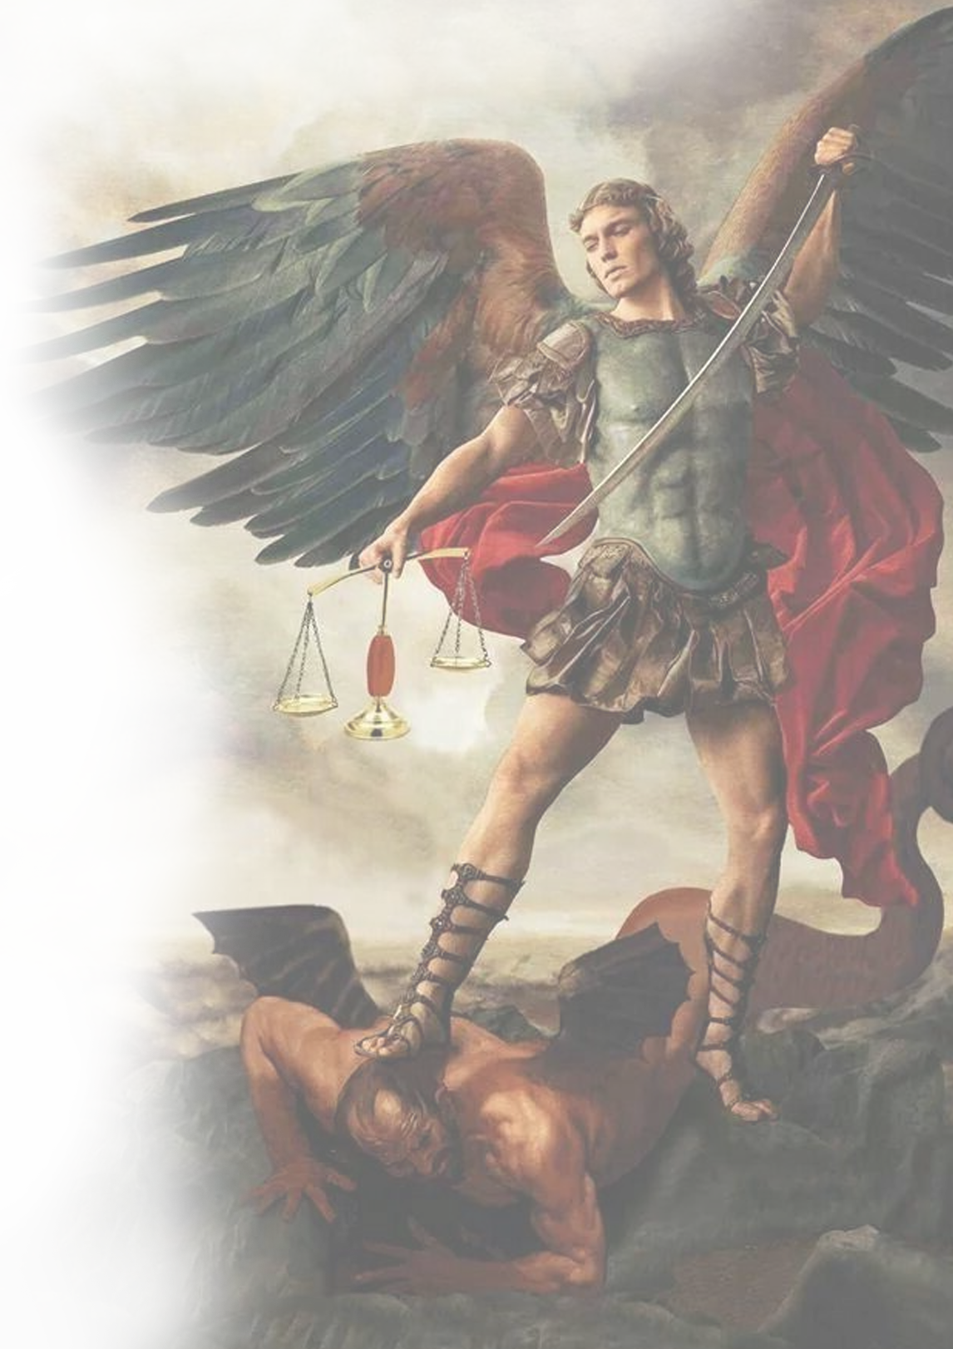
Marian Cenacle Prayer
ALL: PRAYER TO ST. MICHAEL
St. Michael, the Archangel, defend us in battle. Be our protection against the malice and snares of the devil. May God rebuke him, we humbly pray. And do thou, O Prince of the Heavenly Host, cast into hell Satan and all other evil spirits who roam about the world seeking the ruin of souls. Amen.

Slide 51
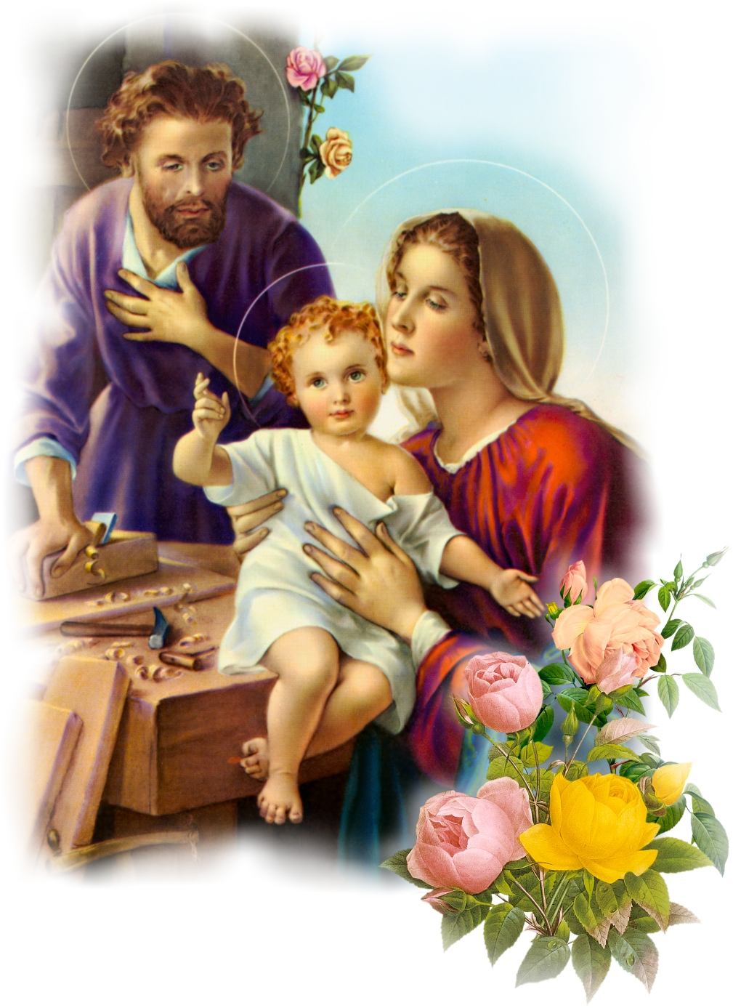
Marian Cenacle Prayer
ALL: FATIMA PRAYER OF REPARATION
My God, I believe, I adore, I hope and
I love Thee! I ask pardon for those who
do not believe, do not adore, do not hope,
and do not love Thee.
ALL: JESUS, MARY AND JOSEPH
Jesus, Mary and Joseph I give You my heart and my soul. Jesus, Mary and Joseph, assist me in my last agony. Jesus, Mary and Joseph, may I breathe forth my soul in peace with You. Amen.
May the Divine Assistance remain always with us. Amen.
Your blessings, Lord, grant upon us, our families and household and those we pray for. Amen

Slide 52
Marian Cenacle Prayer
ALL STAND FOR THE PROCLAMATION
OF THE TRIUMPH
ALL: We proclaim the victory of Our Lord Jesus, Divine Mercy, in His Most Sacred Heart and the Triumph of the Immaculate Heart of Mary in this spiritual battle which we are in, together with St Michael the Archangel, all the angels and saints with the prayer support of the Triumphant, Suffering and Militant Churches, for the honor and glory of the Most Holy Trinity forever and ever. Amen

Slide 53
Marian Cenacle Prayer
SILENT CONTEMPLATION IN GOD’S
DIVINE INDWELLING
THIS IS THE HEART OF THE CENACLE AND KEY TO THE TRIUMPH OF
THE IMMACULATE HEART.

Slide 54
Marian Cenacle Prayer
DIVINE INDWELLING PRAYER
My Lord and my God, Father, Son and Holy Spirit, I believe that You are dwelling in spirit in the deepest center of my soul. I adore You. I love You. And I trust in You; for You are the Source of my being and my life in all that I think, say and do. Help me to see You in the heart of others and see the reflection of You in everything that You have made. Help me to understand the things that I cannot change. And may Your name be praised, blessed and glorified forevermore. Amen.

Slide 55
Marian Cenacle Prayer
THANK YOU FOR JOINING US
IN PRAYING THE CENACLE PRAYER.

